Slide 1
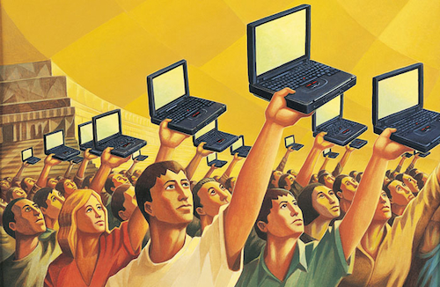
Securing Digital Democracy
Carsten Schürmann, DemTech, IT University of Copenhagen

Slide 2
All but 11 countries held national elections since 2000
[Kofi Annan Foundation Report 2012]
Electoral Management Bodies
want to use of technology!
Notes:
Risks are great
Solutions are complicated
Interdisciplinary

Slide 3
The Voting Process

Slide 4
Electoral System
Social Choice Theory

Slide 5
D’Hondt for (13 Seats)
Party | A | B | C | D | E | F | G | H | I
Total | 2220 | 530 | 665 | 750 | 621 | 1120 | 370 | 335 | 350
1 | 2220 | 1195 | 750 | 621 | 1120 | 707 | 350
2 | 1110 | 598 | 375 | 311 | 560 | 354 | 175
3 | 740 | 398 | 250 | 207 | 373 | 236 | 117
4 | 555 | 299 | 188 | 155 | 280 | 177 | 88
5 | 444 | 239 | 150 | 124 | 224 | 114 | 70
6 | 370 | 199 | 125 | 104 | 187 | 118 | 58
Party | A | B | C | D | E | F | G | H | I
Seats | 5 | 3 |  | 1 | 1 | 2 | 1 |  | 0

Slide 6
Marquis de Condorcet 1743-1794
How to do good decisions?
Algorithms
First Past The Post
Single Transferable Vote
Properties
Majority
Monotonicity
Condorcet Winner
Arrow’s impossibility result

Slide 8
Electoral Systems Families
Source: International IDEA, 2015

Slide 9
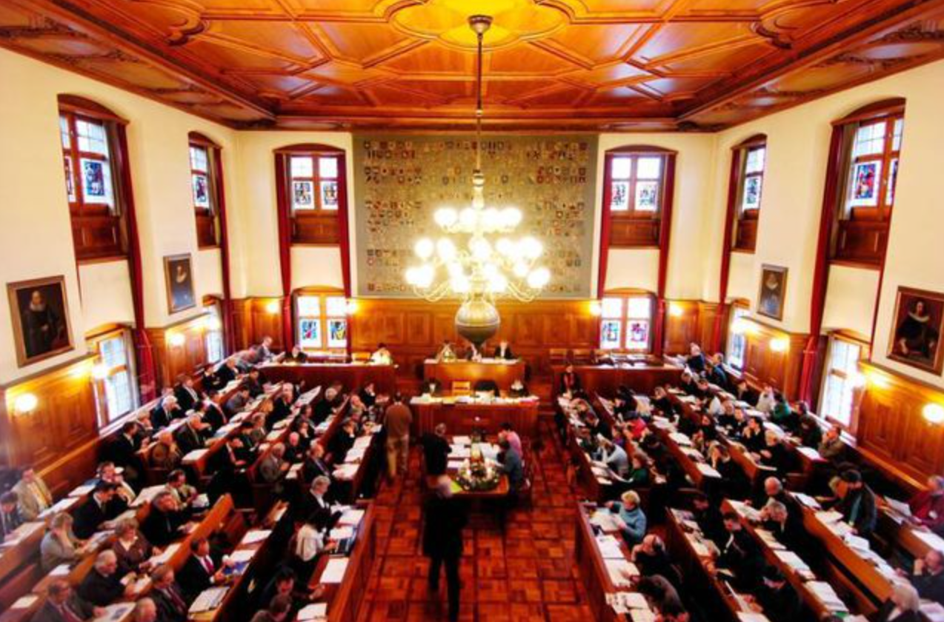
Electoral System Innovation
“Double Pukkelsheim”
This formula determines the result of the “Kantonrats” election next weekend. It increases the likelihood for small parties to gain seats.
Social welfare
Governance
Fairness
Trust
Negative Vote Weight
[Supreme Court Germany]
Zurich, 2007

Slide 10
The Voting Process

Slide 11
Voting Technology

Slide 12
Electronic Voting in Denmark
L-132 [12/13]
Intended to authorize the use of electronic voting machines
No internet elections
No majority in Folketinget
Notes:
Self referential elections
Let’s look at internet elections

Slide 13
Technical Challenge
Secrecy
Integrity
Notes:
Why is it so complicated?

Slide 14
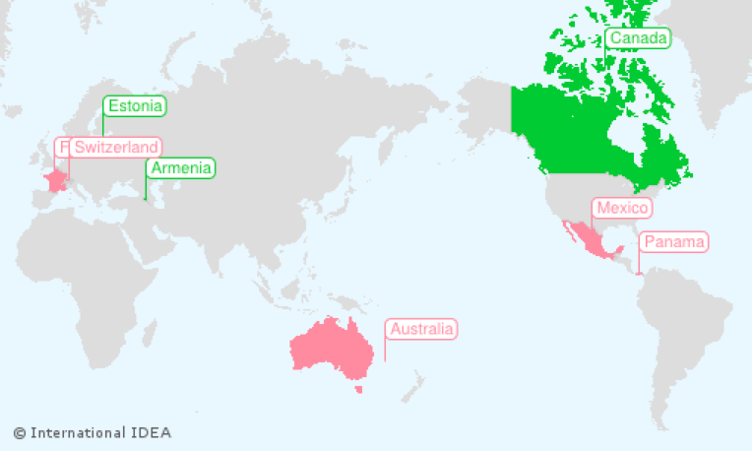
National Binding Internet Elections
Notes:
Why only so few countries?

Slide 15
More and More Countries Consider It!
Geographic challenges
Inclusion of eligible voters living abroad
Hope for increased voter turnout
Hope to encourage young voters to vote
Cost saving
http://www.agora-parl.org, Feb 10, 2015
Notes:
Electoral Management Bodies need to manage risk!

Slide 16
But here are Additional Risks!
Non-Technical Risks
Hiring election helpers
Materials
Ballots
Seals
Pens
Natural disaster
Resource allocation
Technology induced risks
Adversaries
Honest but curious insider
…
Nation State
Software/hardware bugs
Single point of failures
Fall-back procedures
Key management
Notes:
Well understood
Mitigated
Risk registers
Backup plans
Not so well understood
Often outsourced
New risks introduced

Slide 17
What could go wrong?
Digital ballot forms incorrect [NSW 15]
No Entropy [Norway 13]
Configuration problems [Kenya 13]
Double casting of votes [Geneva 12]
Voter card printing problem [Norway 11]
Insecure code [Washington DC 10]

Slide 18
Computer 1
Computer 2
Computer 3
A
A
B
C
C
B
B
A
D
A
C
C
D
B
D
D
D
C
A
B

Slide 19
Credible Elections

Slide 20
Article 21. 3.
The will of the people shall be the basis of the authority of government; this will shall be expressed in periodic and genuine elections which shall be by universal and equal suffrage and shall be held by secret vote or by equivalent free voting procedures.

Slide 21
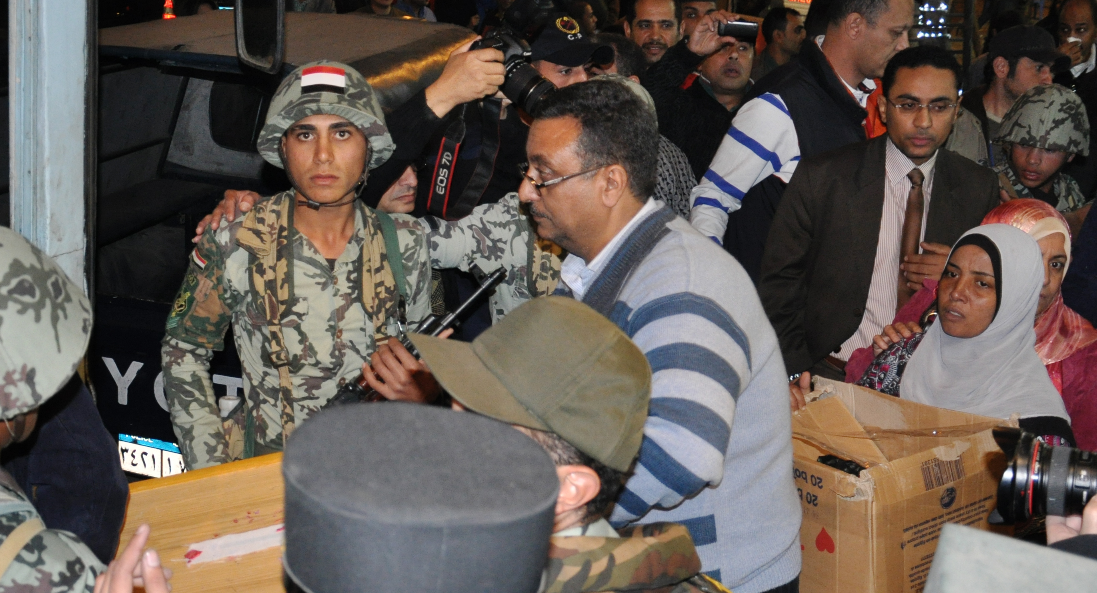
Order, Security, Rule of Law
Egypt November 28, 2011

Slide 22
Internet Ballots in Norway
Norway 2013

Slide 23
Verifiability
Properties:
Cast-as-intended
Recorded-as-cast
Counted-as-Recorded
Cryptographic method:
Zero knowledge proofs
Logical method: Certificates
Statistical method:
Risk limiting audits

Slide 24
Statistical Method
Input: Confidence Level: 99.9%
Audit: Denmark 2014
EU Election: 1903 ballots
Referendum: 60 ballots
Output: Yes/No
Party | A | B | C | D | E | F | G | H | I
Seats | 5 | 3 |  | 1 | 1 | 2 | 1 |  | 0
seed = “90755425186715521560”
max = 2332217
for i=1 to samplesize do
x = seed ^ “,” ^ i
y = sha256 (x)
z = decimal (y)
b = z mod max
end
Notes:
As required by the draft law proposal L133

Slide 25
Conclusion

Slide 26
Electoral Science
Electoral system innovation
Internet elections in a post Snowden world
Education for future generations of experts
Trust in developing and post-conflict countries
Trust in established democracies
Securing digital democracy!

