Slide 1
Mathematical Modeling
Carsten Schürmann
DemTech
April 8, 2015
IEEE-SA VSSC-1622.6

Slide 2
Objective
Legislation
Law
Logical Framework
Data
Computation
Logic
Properties
Proofs
Implementation
Administrative Processes
Software

Slide 3
1. Discourse
Voting Protocol
Cryptography (Privacy, Security)
Statistics (Audits)
Logic (Distribution, Implementation)
Social Choice Algorithms
Complexity
Impossibility
Utility

Slide 4
2. Style
Algorithmic
Algorithm + control flow
Justify the adherence with “specification”
Declarative
Describe the algorithm, no control flow
Justify the adherence with “specification”
Abstract
Describe the “specification”

Slide 5
3. Audience
The Public
Assumptions of common knowledge
Levels of abstraction
Experts
Completeness (no choice left to imagination)
Soundness (must make sense)
Courts
Verifiability
Dispute resolution

Slide 6
Logical Framework ToolBox
Logical Framework
Data: Votes, Ballots, Totals
Computation: Algorithms

Slide 7
Pictoral Presentation
“A picture says more than 100 words”
Examples: Category Theory, Geometry, Trigonometry

Slide 8
Declarative (Algebraic) Presentation
Constructive Logics:
“If there is a solution then there is a program that actually computes it!”
Let P=(x_{P},y_{P}) and Q =(x_{Q},y_{Q})
Define R = P + Q where R = (x_{R},y_{R})
Case 1: P ≠ Q and –P ≠ Q
x_{R} = s² – x_{P} – x_{Q}
y_{R} = – y_{P}+ s(x_{P} – x_{Q})
s = (y_{P} – y_{Q})/(x_{P} – x_{Q})
Case 2: -P = Q
P + Q = ∞
Case 3: P = Q
P+ Q = 2P

Slide 9
Dataflow Presentation
P=(x_{P},y_{P})
Q =(x_{Q},y_{Q})
P = Q
R = (2x_{R,} 2y_{R})
-P = Q
R = ∞
s = (y_{P} – y_{Q})/(x_{P} – x_{Q})
x_{R} = s² – x_{P} – x_{Q}
y_{R} = – y_{P}+ s(x_{P} – x_{Q})
R = (x_{R,} y_{R})

Slide 10
Formal Presentation
Logics
Intuitionistic Logic
Linear Logic
Temporal Logic
Dynamic system
Model Checker
Type theories
Active area of research
Coq, Agda, Twelf
Tool support essential
“A formalization of Elliptic Curves” in Coq

Slide 11
Logic ToolBox
Logic
Properties: Requirements, Specifications
Proofs: Arguments, Equivalences

Slide 12
Logics
For all points P + Q it holds: P + Q = Q + P
And in the Coq system:
First-order logic
KeY system
Higher-order logics
Temporal Logic
Model Checker
Type theories
Active area of research
Coq, Agda, Twelf

Slide 13
Case Study First-Past the Post
Logical Framework: Linear Logic
“The Logic of Food” * -o
Logic: First-order Logic

Slide 14
Objective
Legislation
Tally all ballots for each hopeful candidate.
Logical Framework
Data
Computation
Implementation
Administrative Processes
Software

Slide 15
Declarative Statement
If you count ballots
find an uncounted ballot for C
where C is still in the race
then increase C’s tally
and continue counting
count-ballots (U + 1) H *
uncounted-ballot C *
hopeful C N
-o (hopeful C (N + 1) *
count-ballots U H)
Propositions:
count-ballots U H
uncounted-ballot C
hopeful C N
Number uncounted ballots: U
Number hopefuls: H
Name of a candidate: C
Number of ballots in a tally: N

Slide 16
Objective
Legislation
Tally all ballots for each hopeful candidate.
Logical Framework
Data
Computation
Logic
Properties
Proofs
Implementation
Administrative Processes
Software

Slide 17
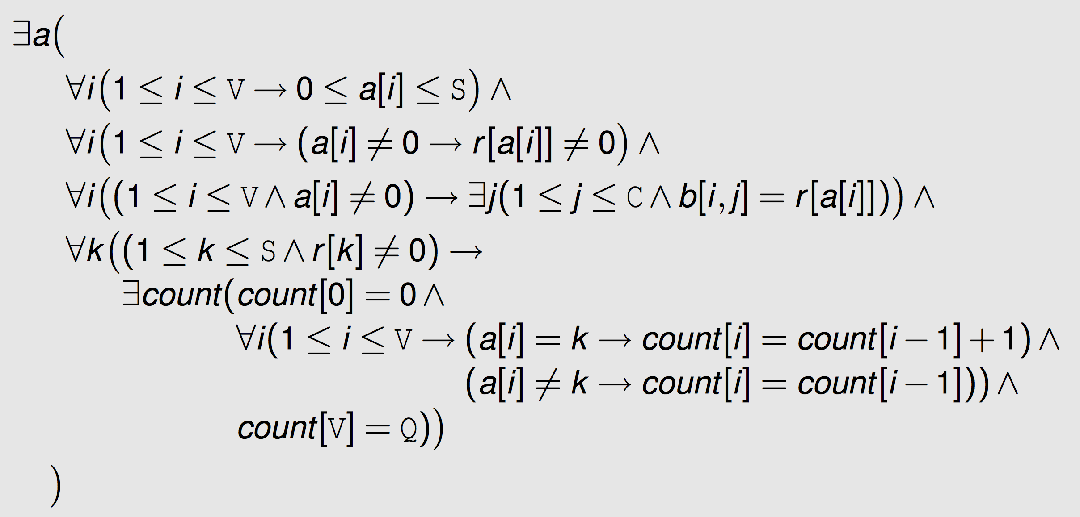
Abstract Specification: Each Vote is Counted Once

Slide 18
Conclusion
Narrowing the gap between law and maths
Laws easier to interpret, implement
Completeness
Soundness
Analysis becomes easier
Long term benefits

